Slide 1
The Graduated Approach @FaithPrimary
Our recent SEND parent voice highlighted some areas that parents would like extra information about. The following slides should answer all of your queries and if you have any more questions regarding SEND please contact Miss Fox.

Slide 2
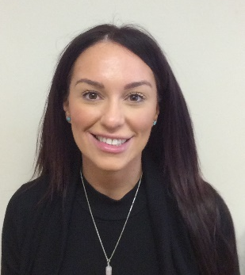
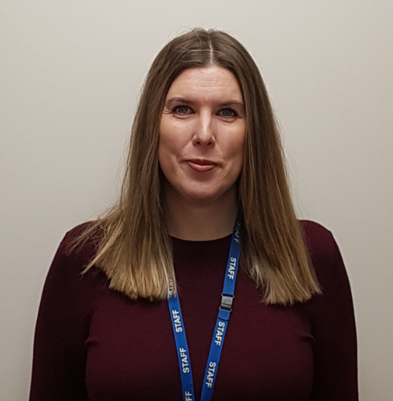
Who leads inclusion?
Miss Fox is the Inclusion Manager at our school. It is her job to work with children, teachers, parents and outside agencies. Miss Fox is also our SENCO, which means Special Educational Needs Co-Ordinator.
Miss Williams is the Head teacher. Part of her role is to work with the SENCO to determine the strategic development of SEND policy and provision within the school.

Slide 3
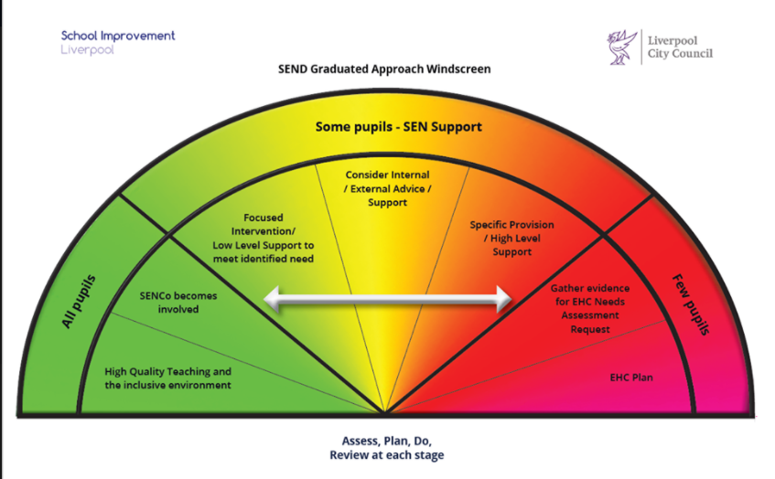
How is my child supported?

Slide 4
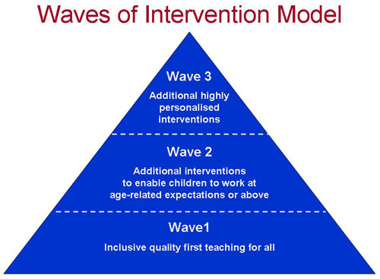
What are interventions?
When children have been identified as needing further intervention the SENCO will carry out observation and assessments, combined with discussions with parents and outside agencies where appropriate.
Barriers to learning will be identified. Planned interventions or adaptations to class or work addressed and then reassessed to see the impact in a plan, do, review cycle.

Slide 5
What interventions do Faith use?
Wave 1 | Wave 2 | Wave 3
High quality teaching Questioning Word mats Toolbox Pencil grips Wobble cushions Seating plans Practical equipment Reward charts Step by step instructions TA support Differentiation Visual timetable ICT equipment | Social Skills First class at number Numbers counts Reading comprehension Pobble 365 Catch up Phonics Toe by Toe Sensory Circuits Lego therapy Barrier games Reading recover Precision Teaching Wellcom Elklan Reading wise Flash Dyslexia counts Sanctuary Suite | Seedlings ADHD Foundation Education Psychologist OSSME Springwood Heath

Slide 6
How will I know if my child is receiving an intervention?
If your child is placed into a Wave 2 or Wave 3 intervention you will receive a letter to inform you and if you wish you can contact Miss Fox for more in formation. Wave 1 interventions will be discussed with the class teacher, this may be via a phone call or at parents evening, depending on the intervention needed.

Slide 7
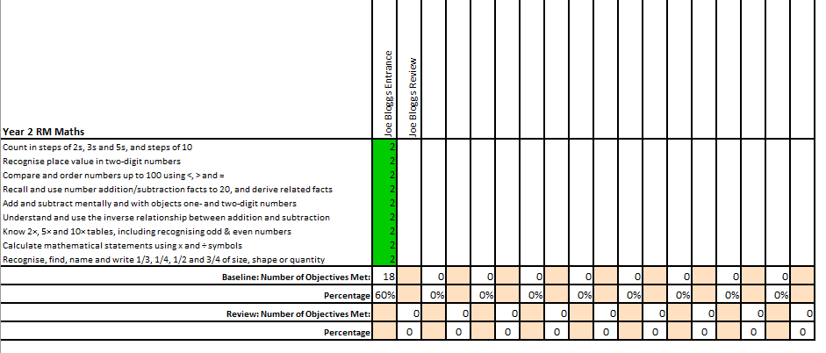
How do you know if the interventions have worked?
We complete pre and post assessments based around the skills your child needs support with. The progress made and next steps will be shared with you at the end of the intervention block. This can then be discussed with Miss Fox if you wish.

Slide 8
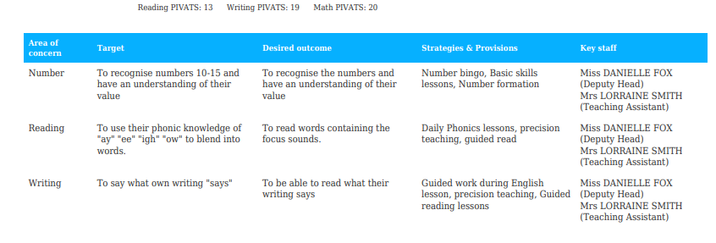
How do you know what my child needs support with?
Every child working below age related expectations is assessed termly using a program called PIVATS. This allows the teacher to identify targets each child needs to work on over the next term. This information is then shared with you at parents evening in the form of a learning plan which you should sign and receive a copy of.

Slide 9
Who else can I ask for support?
This best place to look for support is our Twitter page as we often retweet organisations offering support and free virtual training.
@FaithPrimary

