Slide 1
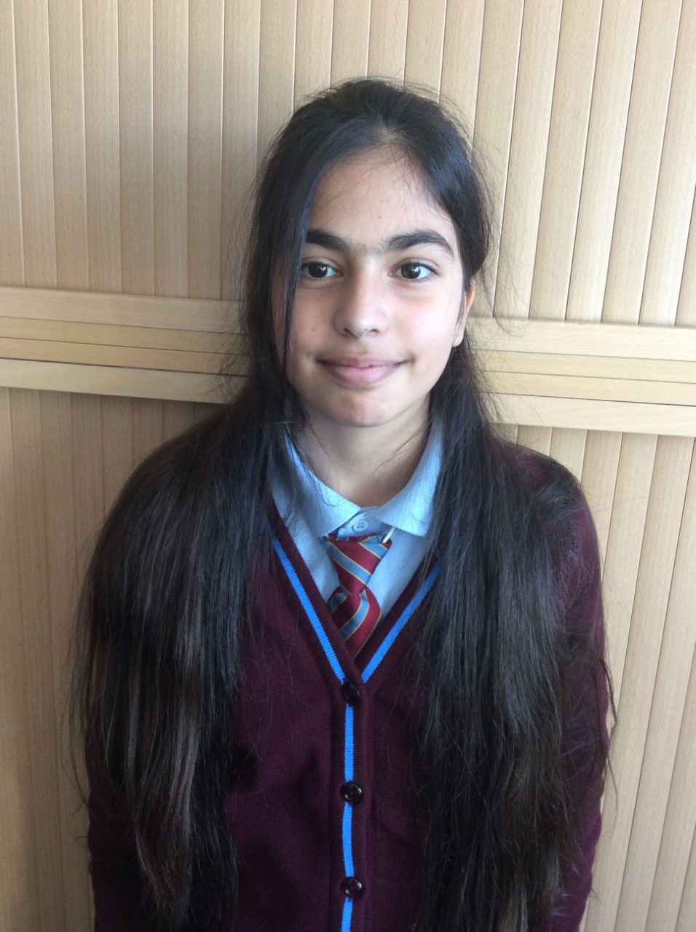
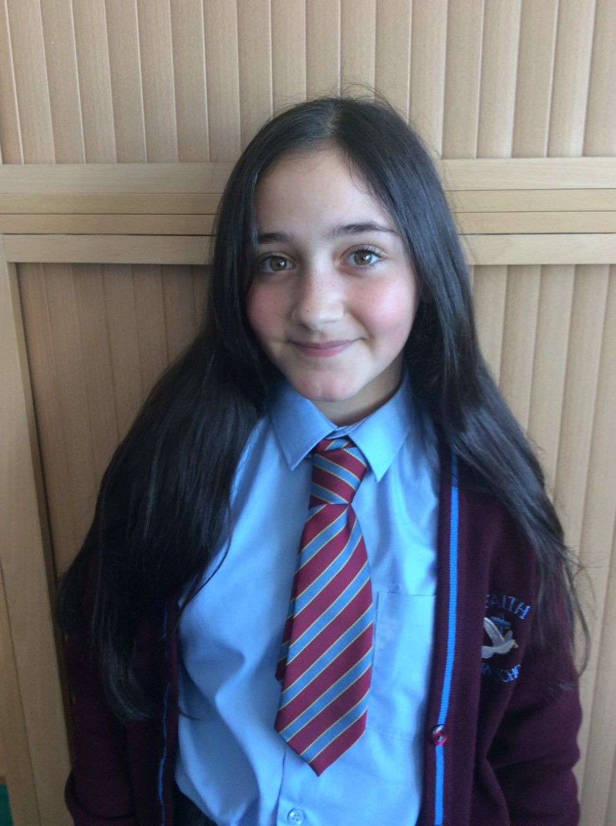
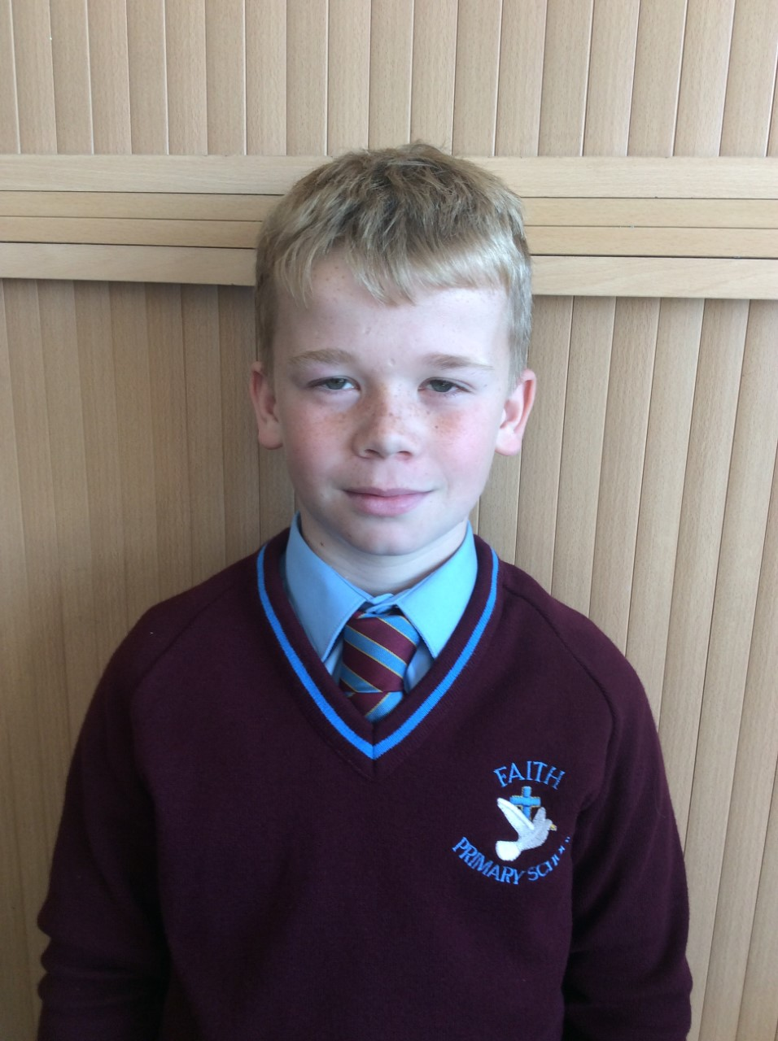
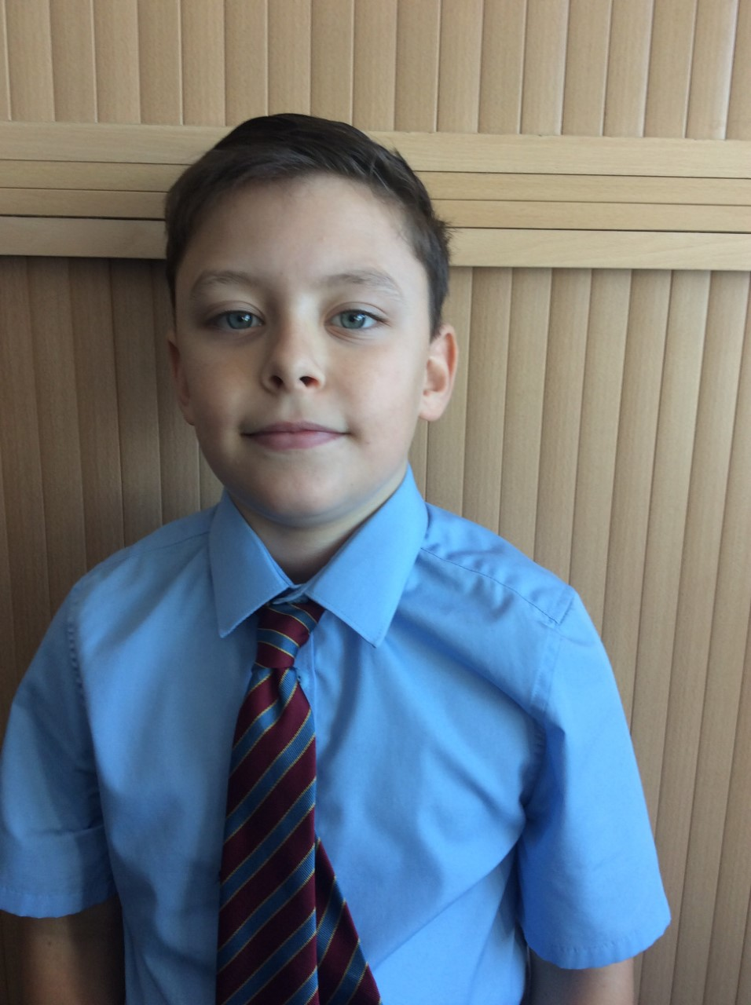
The Regulation Responders

Slide 2
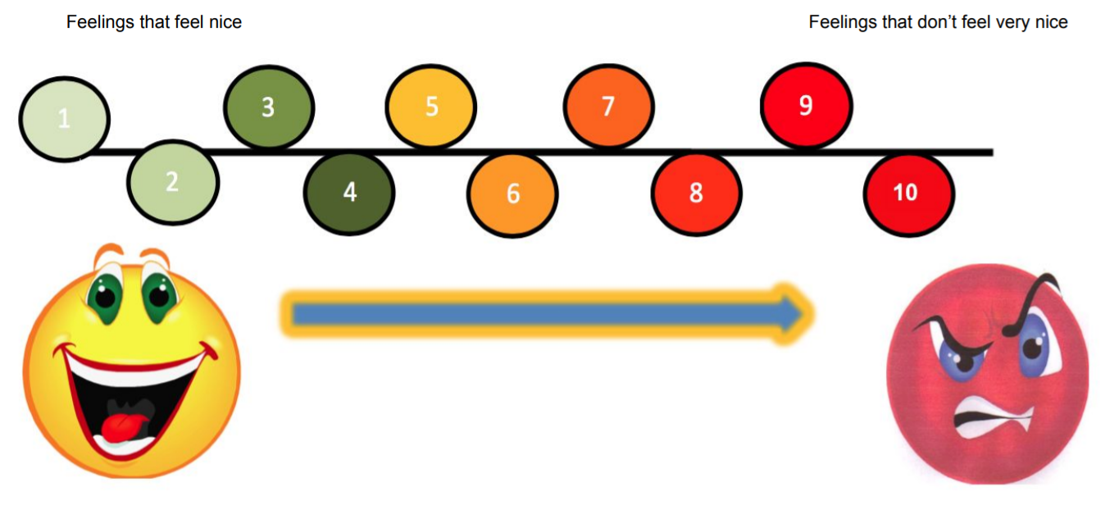
Where are you on the scale?
The Regulation Responders

Slide 3
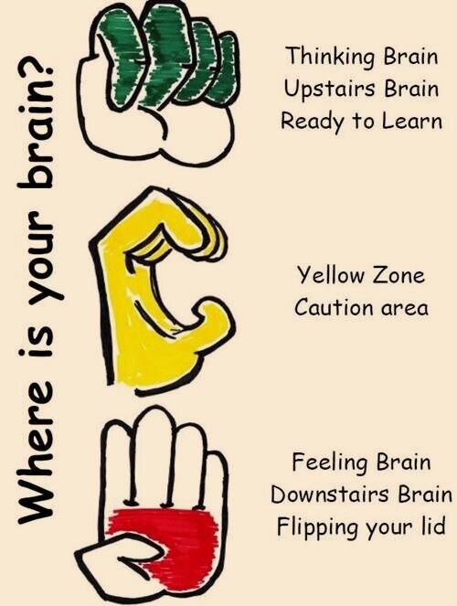
Pre-frontal cortex (front of your brain) is engaged.
You feel calm, relaxed and ready to learn.
Pre-frontal cortex (front of your brain) is starting to not engage. You feel silly, excited or frustrated.
Pre-frontal cortex (front of your brain) is not engaged.
You feel angry, you are unable to make good decisions, you need time to calm down.
The Regulation Responders

Slide 4
https://www.youtube.com/watch?v=so8QN9an3t8&t=1s
The Regulation Responders

Slide 5
Top Tips for calming your guard dog
The Regulation Responders

Slide 6
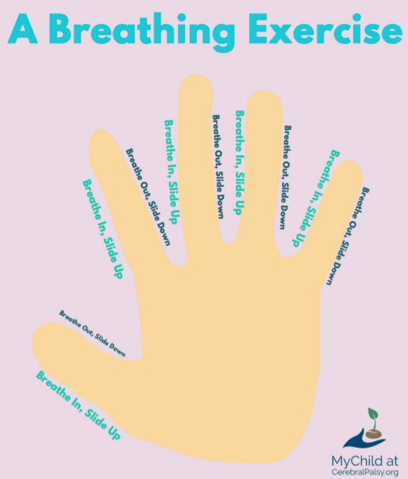
Breathing exercises
The Regulation Responders

Slide 7
Speak to your owl
The Regulation Responders

Slide 8
Have a drink

Slide 9
Lazy 8 Breathing

Slide 10
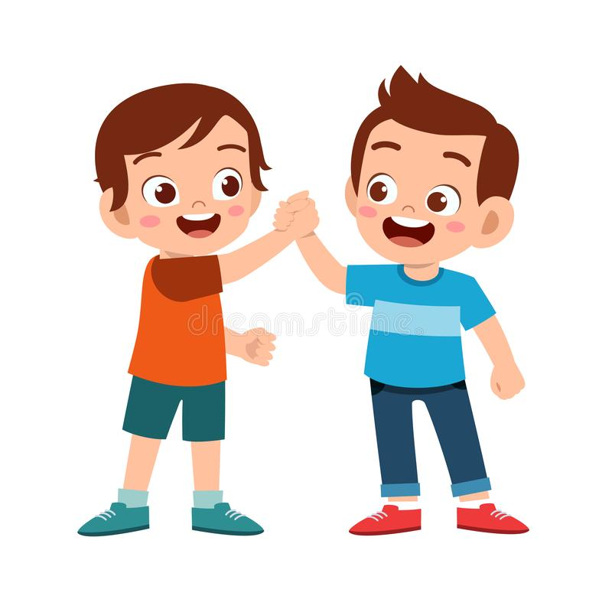
Speak to a friend

Slide 11
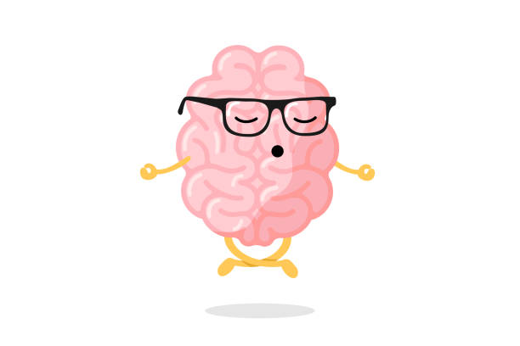
Mindfulness and Meditation

Slide 12
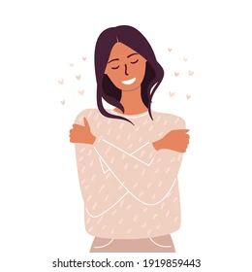
Accept your emotion and understand it is normal to feel that way.

Slide 13
Our Role
We are the Regulation Responders.
The Regulation Retrievers will collect check-ins in the morning.
They will then inform a teacher, who may want to speak to you about your emotions.
Our job, is to support you at break time and lunch time.
We can provide you with some ideas on how to calm your guard dog.
We will be there to support you.
The Regulation Responders

Slide 14
Does anybody feel like they would like us to support you today?
You don’t have to tell us in front of everyone, but we are here if you would like to quietly talk to us.
The Regulation Responders

Slide 15
Any questions?
The Regulation Responders

